Slide 1
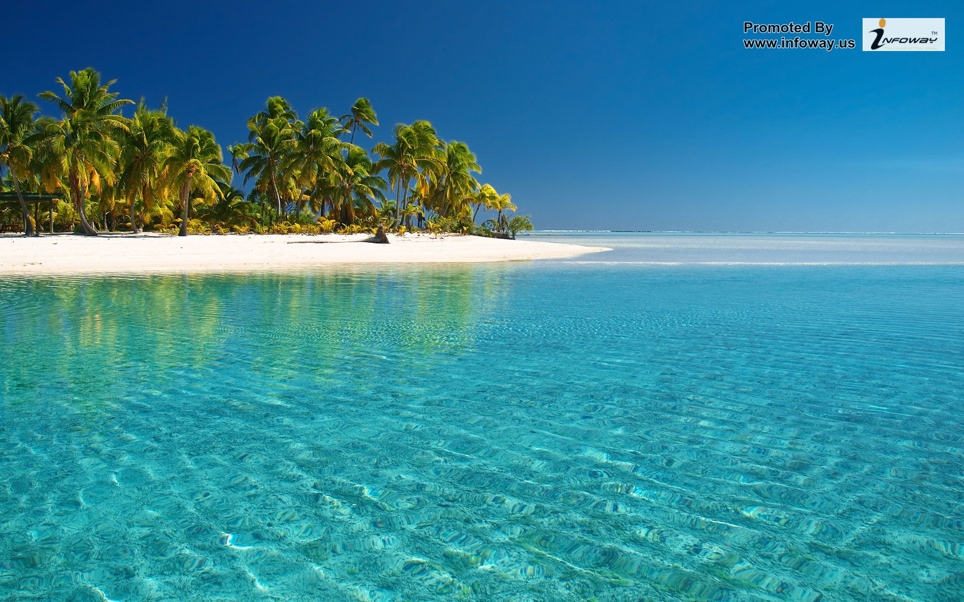
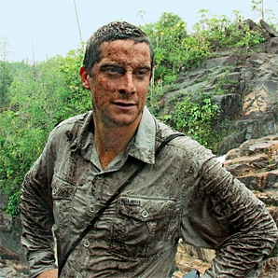
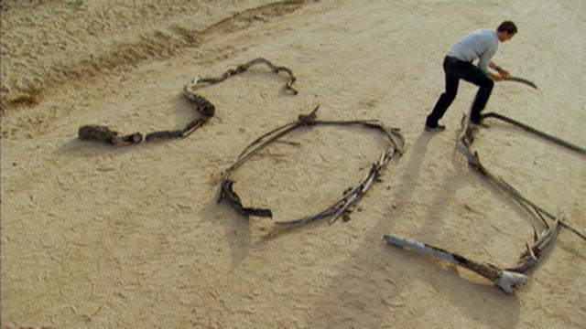
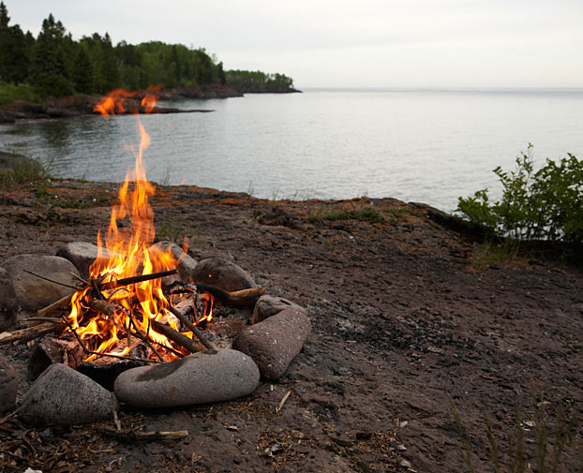
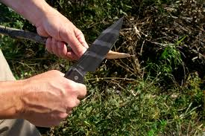

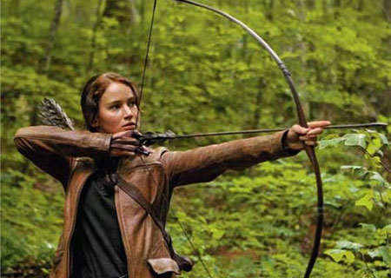
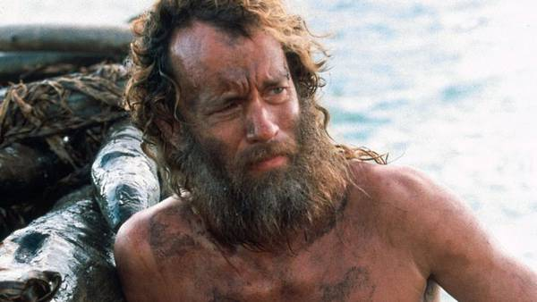
Q- What do these pictures have in common?

Slide 2
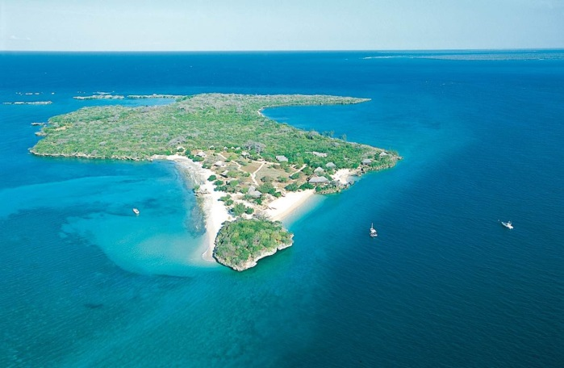
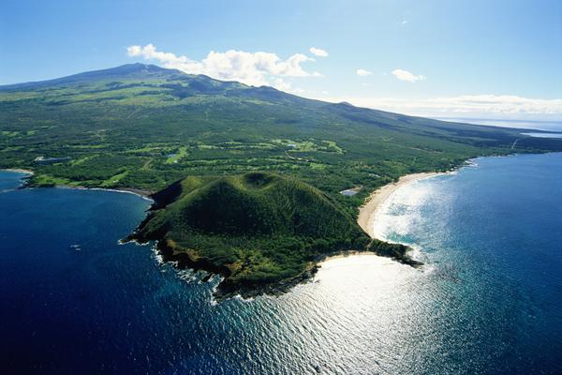
A: Survival!
All the images shown in the starter activity have a purpose to inform the reader about how to survive in a particular situation
You need to consider how a person could survive on your island

Slide 3
Lesson Objective
LO: to study a range of non-fiction texts and select key information to help someone survive on a deserted island

Slide 4
Survival Skills
Challenge 1
Watch a video about survival: come up with key areas/themes for survival. These will be your areas for research.
https://www.youtube.com/watch?v=SKRH1J2Vnrw
Challenge 2:
Now research survival using texts provided- selecting key information and making notes under your headings.

Slide 5
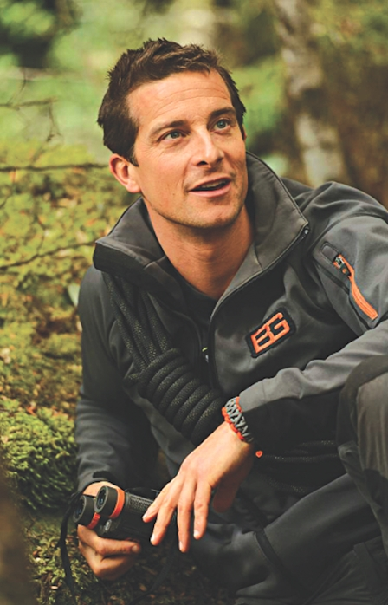
What have we learnt?
Any tips for effective note taking?
What areas have you chosen for your survival guides? Can you add any more?
Shelter
Dangers
Food
clothing
Water
Fire

