Slide 1
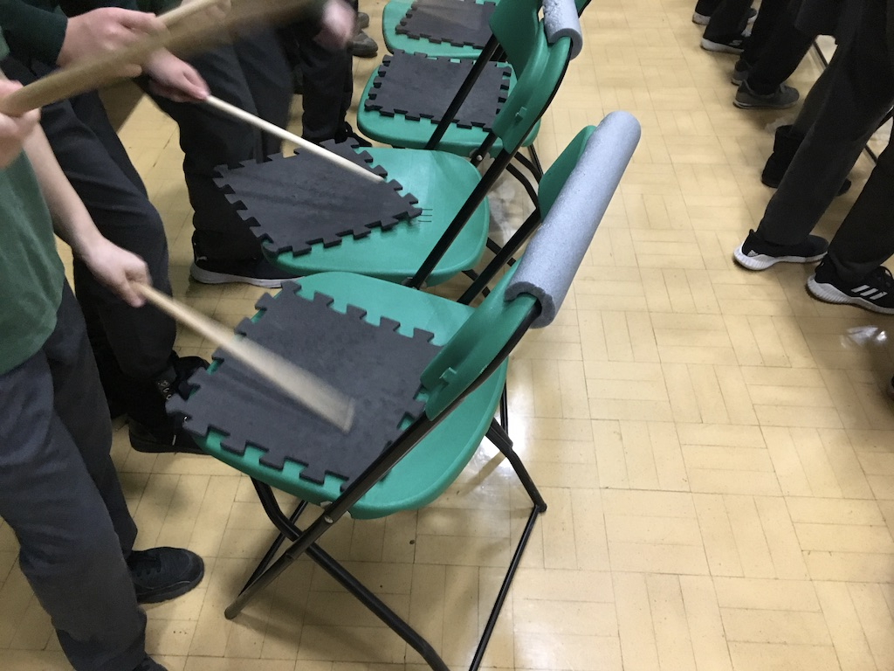
Just Play
Chair Drumming Vol.2
Disclaimer: This resource is licensed for UK use only. Any unauthorised copying or re-selling of the resource will constitute an infringement of copyright.

Slide 2


Slide 3
Acknowledgments
Just Play Resource: co-created by Musical Futures and Musical Futures Australia
Video creation: Reece Cairns
The approach and resources have been inspired by Little Kids Rock (www.littlekidsrock.org) – a USA not-for-profit organisation that provides free music instruction and instruments to under-served public school districts across the United States.
St. David's Office,
Park Road South,
Newton-le-Willows,
WA12 8EY
P: +44 (0)7985 188889
E: info@musicalfutures.org
www.musicalfutures.org
Disclaimer: This product is not for sale. Any unauthorised copying or re-selling of the resource will constitute an infringement of copyright. © Musical Futures July 2018

