Slide 1
LO: To learn about aspects of Lent and Easter

Slide 2
Holy week
Holy Week is the most important week in the Christian Calendar.
It is a week of festivals that commemorate the death and resurrection of Jesus.
It consists of several festivals that mark the end of Jesus’ life:
Palm Sunday
Maundy Thursday
Good Friday
Easter Sunday

Slide 3
Why is Holy Week so important?
They believe he proved this when he died on the cross and was later resurrected.
This shows that he has power over death.
Christians also believe that, by being crucified, Jesus sacrificed himself for us. His death makes it possible for humanity’s sins to be forgiven and for people to enter heaven.

Slide 4
Palm Sunday
Palm Sunday is the first day of Holy Week.
Holy Week ends a week later with Easter Sunday.
Palm Sunday also marks the beginning of the last week of Jesus’ life.

Slide 5
What happened on Palm Sunday
On Palm Sunday, Jesus entered Jerusalem.
Through his preaching, Jesus had made enemies amongst several Jewish groups.
However, when he entered Jerusalem many Jews are pleased to see him and listen to his teachings.
According to the Bible, this makes his enemies plot to destroy him.
The Bible says that, as Jesus entered Jerusalem, people threw palms down in his path.

Slide 6
What do Christians do on Palm Sunday?
On Palm Sunday, many Christians hold services that show their dedication to Christianity.
They do this by holding palms or crosses made of palm leaf during processions.

Slide 7
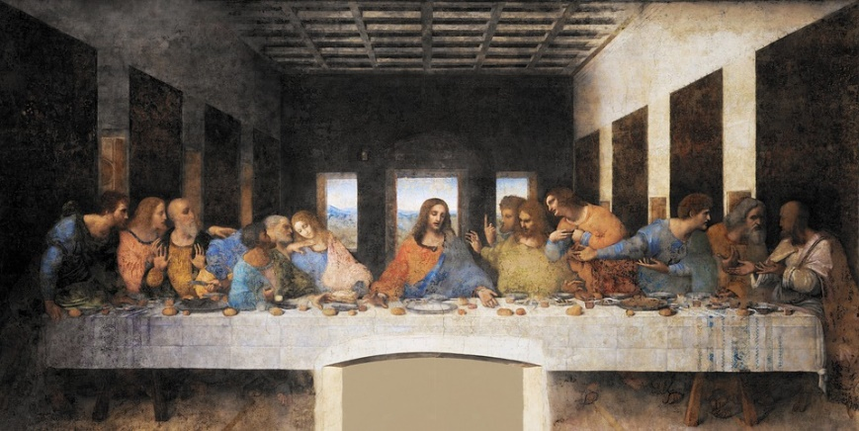
What is Maundy Thursday?
Maundy Thursday is held each year on the Thursday of Holy Week.
It is also known as Holy Thursday.
It is a commemoration of the Last Supper of Jesus. This is a key event in Christian history, which occurred just before Jesus’ crucifixion.
https://www.bbc.co.uk/bitesize/clips/zn497ty

Slide 8
Maundy Thursday – The Last Supper
This is the final time Jesus is gathered with his disciples. During the meal, Jesus speaks to them all for the last time.
During the Last Supper, Jesus gave bread and wine to his disciples. He famously said that these were his body and blood and asked his followers to perform this ritual in memory of him.
Christians remember this when they receive Holy Communion (also referred to as the Eucharist). This is a important part of worship for many Christian groups.
At the Last Supper Jesus also washed his disciples feet.

Slide 9
Maundy Thursday – Jesus’ betrayal and arrest
Maundy Thursday also commemorates Jesus’ betrayal and arrest.
Judas, one of Jesus’ disciples, betrays him to his enemies in return for thirty pieces of silver. This allows them to arrest Jesus, which will later lead to his crucifixion.
However, Judas is not the only one of his disciples to let Jesus down. Peter, one of his closest followers, pledges his allegiance to Jesus at the Last Supper. However, he later denies knowing him to avoid arrest.

Slide 10
What is Good Friday?
Good Friday commemorates Jesus’ death.
It is a sombre and reflective time for Christians.
This contrasts to the joyful celebration of Easter Sunday.
On Good Friday, many Catholic Christians will take part in a special ceremony known as the ‘Stations of the Cross’. This involves retelling the story of Jesus’ death through images.
https://www.learnreligions.com/timeline-of-jesus-death-700226 (Timeline of events taking place on Good Friday).

Slide 11
Why is Good Friday important to Christians?
Good Friday is an important occasion for Christians.
Christians believe that Jesus’ death has saved them from sin and given them the opportunity to enter heaven.
Good Friday also sets up the miraculous events that will occur on Easter Sunday, which is Christianity’s most important festival.

Slide 12
What is Easter Sunday?
Easter Sunday is the final festival of Holy Week.
It is a joyful occasion and the most important one in the Christian calendar.
It comes after Good Friday, the day Christians believe Jesus died.
Easter Sunday is the day Christians believe Jesus was resurrected.

Slide 13
Luke 24: 1-9

Slide 14
Why is Jesus’ resurrection important?
Jesus’ resurrection is the most important event in Christian history.
It shows Jesus has power over death and therefore must be the Son of God.
This event therefore validated all of Jesus’ teachings and led to the foundation of Christianity.

Slide 15
What do Christians do on Easter Sunday?
On Easter Sunday, Christians hold joyful services that celebrate Jesus’ resurrection and the possibility of new life.
The tradition of giving Easter eggs also has a Christian origin. Christians began using eggs as part of the Easter celebrations as a way of showing we will have a new life in Jesus Christ. Orthodox Christians still paint eggs as part of their preparations for Easter.

