Slide 1

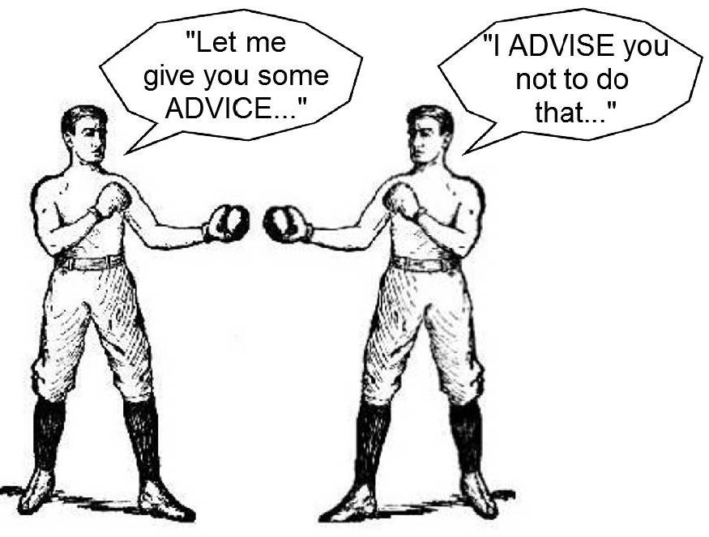
Homophones

Slide 2
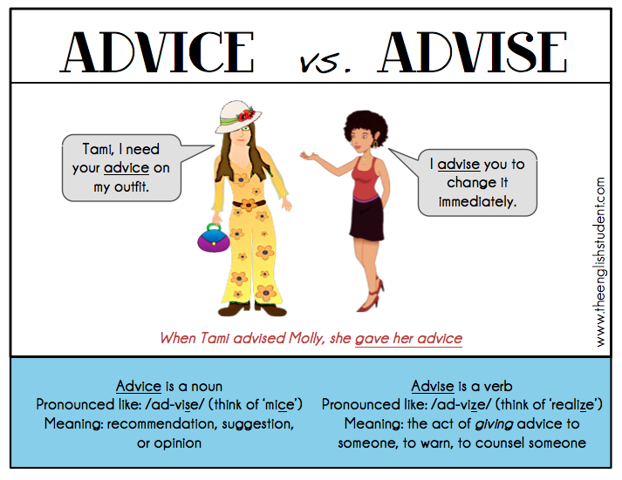
Homophones

Slide 3
Lesson Objective
In today’s lesson you will:
Begin creating a survival guide aimed at helping someone survive on your island
Write to advise and inform
Use technical vocabulary

Slide 4

Survival Guide
Challenge: plan and create your survival guide using your key areas as subheadings
Challenges:
Introduce your booklet
Include a range of methods of presenting information (e.g. headings, subheadings, bullet points, diagrams),
use technical vocabulary
Be factual – good advice

Slide 5
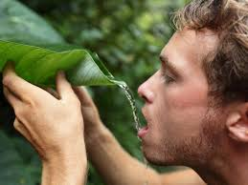
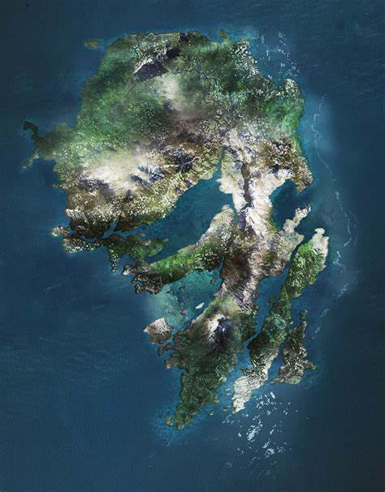
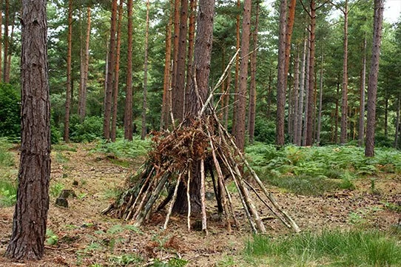
PresentationPresentationPresentation!
How to Survive
On
Skull Island
Take Shelter!
Food &
Water
SH
SH
A rough guide to how to survive the dangers and challenges of one of the most remote, deserted islands in the world…

