Slide 1
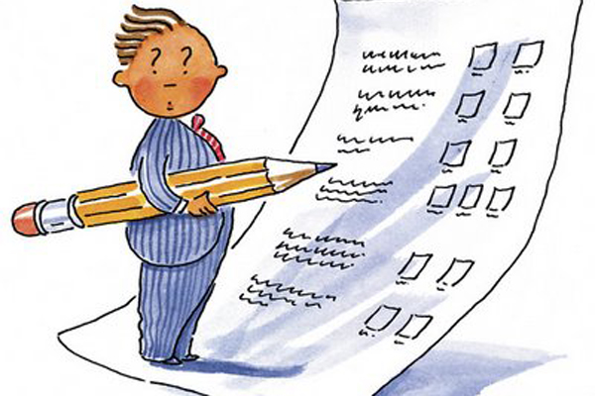
Assessing Progress…

Slide 2
Lesson Objective
In today’s lesson you will:
Continue to create a survival guide aimed at helping someone survive on your island
Write to advise and inform
Use technical vocabulary

Slide 3
Survival Guide
Must be informative
Must give advice
Must contain subheadings
Must contain images
Challenge:
include a range of methods of presenting information (e.g. bullet points, thought showers, diagram), an introduction and use technical vocabulary

