Slide 1
Lesson Objective
In today’s lesson you will:
Explore what makes an effective narrative opening
Analyse fictional openers

Slide 2
Narrative Opening
A good narrative should hook the reader by providing intrigue. It could introduce a character or setting (or both), but most importantly make the reader want to read on to find out more.

Slide 3
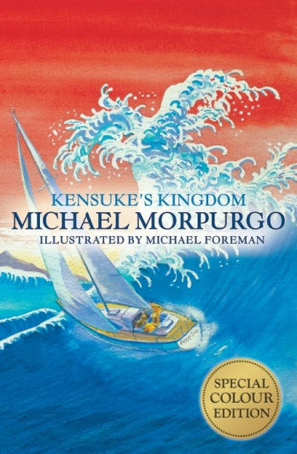
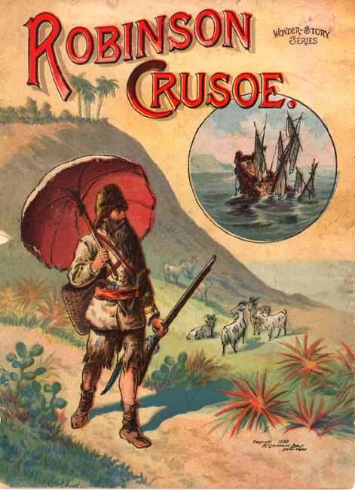
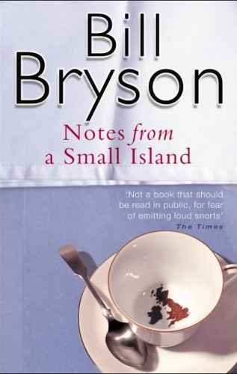
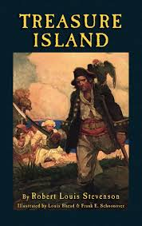
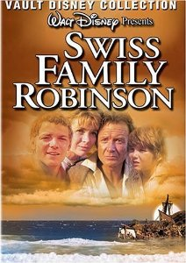
Analysing Openers…
What is so effective about the opening?
Consider the following:
style (formal/informal);
writer’s choice of vocabulary;
descriptive techniques used;
voice of the narrator;
how a character is introduced;
Use of dialogue/action;
variety of sentence structure;
use of punctuation for effect.

Slide 4
Kensuke’s Kingdom Opening
I disappeared on the night before my twelfth birthday. July 28 1988. Only now can I at last tell the whole extraordinary story, the true story. Kensuke made me promise that I would say nothing, nothing at all, until at least ten years had passed. It was almost the last thing he said to me. I promised, and because of that I have had to live out a lie. I could let sleeping lies sleep on, but more than ten years have passed now. I have done school, done college, and had time to think. I owe it to my family and to my friends, all of whom I have deceived for so long, to tell the truth about my long disappearance, about how I lived to come back from the dead.

Slide 5
Treasure Island Opening
Squire Trelawney, Dr. Livesey, and the rest of these gentlemen having asked me to write down the whole particulars about Treasure Island, from the beginning to the end, keeping nothing back but the bearings of the island, and that only because there is still treasure not yet lifted, I take up my pen in the year of grace 17—, and go back to the time when my father kept the "Admiral Benbow" inn, and the brown old seaman, with the saber cut, first took up his lodging under our roof. I remember him as if it were yesterday, as he came plodding to the inn door, his sea-chest following behind him in a hand-barrow; a tall, strong, heavy, nut-brown man; his tarry pig­tail falling over the shoulders of his soiled blue coat; his hands ragged and scarred, with black, broken nails; and the saber cut across one cheek, a dirty, livid white. I remember him looking round the cove and whistling to himself as he did so, and then breaking out in that old sea-song that he sang so often afterward:
"Fifteen men on the Dead Man's Chest— Yo-ho-ho, and a bottle of rum!"

Slide 6
What does the description reveal about the mysterious character?
‘Plodding’
‘Soiled blue coat’
‘Ragged and scarred’
‘A dirty livid white’

Slide 7
Narrative Openings
E-D: Read a variety of narrative openings and highlight/annotate effective use of features to engage the reader.
D-S: Choose the one you think is most effective and carefully stick it into your book – with annotations
S-M: Analyse the opening using Point, Evidence, Explain, Effect on the reader.

Slide 8
How does the writer engage the reader in the opening?
EXAMPLE:
In Treasure Island, the writer introduces a mysterious character and engages the reader through vivid description . ‘…his hands ragged and scarred, with black, broken nails; and the saber cut across one cheek, a dirty, livid white.’
The use of a complex sentence here emphises the adjectives chosen: presenting the character as someone not to be messed with. The effect on the reader would be to immediately cause them to be curious about this unusual character – and what impact he will ultimately have upon the first person narrator and the story itself.

Slide 9
Purple Box Question
Analyse the opening using Point, Evidence, Explain, Effect on the reader.
P: This opening is particularly effective as it…
E: ‘Present your quote’ using quotation marks
E: This is an effective technique because…
E: The effect on the reader would be…

Slide 10
SELF ASSESS
D: Explain how the writer uses features- such as vocabulary choices- to engage the reader. (Point with basic explanation)
S: Explore how the writer uses techniques effectively to engage the reader using evidence from the text to support your ideas. (Points with appropriate evidence – some valid explanation)
M: Analyse the effectiveness of the writer’s techniques used to engage the reader. (PEEE- include close analysis of the technique used and explain the intended effect on the reader)

