Slide 1
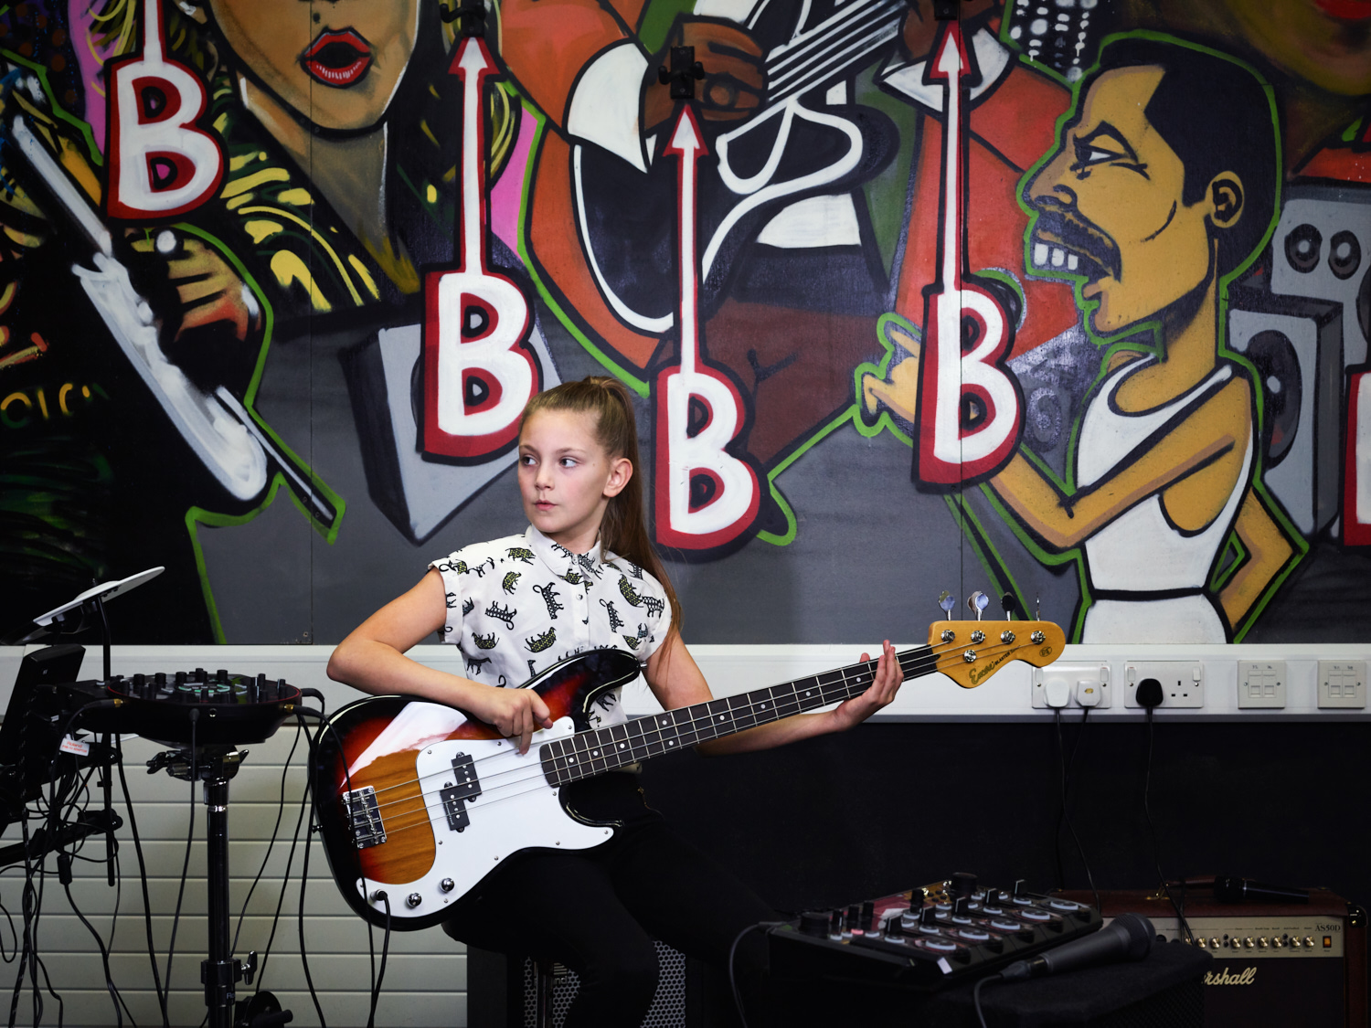
Just Play Drums!
Chair Drumming
Disclaimer: This resource is licensed for UK use only. Any unauthorised copying or re-selling of the resource will constitute an infringement of copyright.

Slide 2
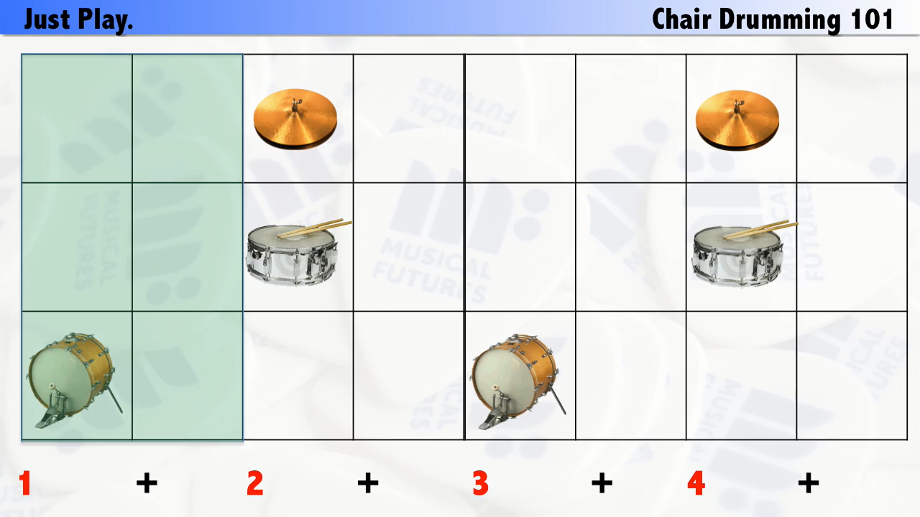

Slide 3
Getting involved with us
All other resources available at www.musicalfutures.org/resources
Trial the approaches
Follow Musical Futures UK on Twitter (@mufuturesUK) and join in the weekly #mufuchat on Facebook (8pm GMT Wednesdays UK)
Share practice in the Musical Futures Facebook group and with each other
Share any resources you develop http://www.musicalfutures.org/resource-type/teacher-created
Write a guest blog for the Musical Futures communityhttp://www.musicalfutures.org/news
Check out the Musical Futures training programme now running across the UK https://www.musicalfutures.org/training

Slide 4

Acknowledgments
Just Play Resource: co-created by Musical Futures (Anna Gower) and Musical Futures Australia (Ken Owen)
Video creation: Reece Cairns (UK) and Steve Sajkowsky (Australia)
Teacher guidance notes: Anna Gower, Martin Ainscough and Etain Ferdenzi
The approach and resources have been inspired by Little Kids Rock (www.littlekidsrock.org) – a USA not-for-profit organisation that provides free music instruction and instruments to under-served public school districts across the United States.
With grateful thanks to the following for their input and support with the creation of these materials: Abigail D’Amore, Ian Harvey, Ann Barkway, Fran Hannan, Peter Romhany, Alexandra Clarke, Kevin Grist, Peter Wardrobe.
Disclaimer: This resource is licensed for UK use only. Any unauthorised copying or re-selling of the resource will constitute an infringement of copyright. © Musical Futures September 2016

